Slide 1
Lecture 9
Responsive Design
Build webpages that adapt to different screen sizes.

Slide 2
Today's Agenda
Session Objectives
Review CSS positioning concepts from the previous lecture
Understand the foundations of Responsive Design
Explore common viewport sizes
Use responsive CSS units
%, rem, vw, vh, em
Write Media Queries
Understand breakpoints
Apply the Mobile-First approach
Build a responsive Course Landing Page

Slide 3
Warm-up

Slide 4
Question 1
Which CSS property controls how an element is positioned on a webpage?
A. display
B. position
C. margin
D. overflow
Answer: B

Slide 5
Question 2
Which statement correctly describes position: relative?
A. The element is removed from normal document flow.
B. The element moves relative to its original position while its original space remains reserved.
C. The element is positioned relative to the viewport.
D. The element ignores the top, right, bottom, and left properties.
Answer: B

Slide 6
Question 3
Which element provides the positioning reference point for .label?
HTML
<div class="card">
<span class="label">New</span>
<h2>Frontend Course</h2>
</div>
A. The viewport
B. The body element
C. .card
D. The h2 element
styles.css
.card {
position: relative;
}
.label {
position: absolute;
top: 8px;
right: 8px;
}
Answer: C

Slide 7
Question 4
Which CSS rule makes each navigation link begin on a new line?
A. nav a { display: inline; }
B. nav a { display: block; }
C. nav a { display: none; }
D. nav a { position: block; }
Answer: B

Slide 8
Question 5
Two positioned elements overlap. Which CSS property controls which element appears in front?
A. overflow
B. padding
C. z-index
D. margin
Answer: C

Slide 9
Responsive Design Basics

Slide 10
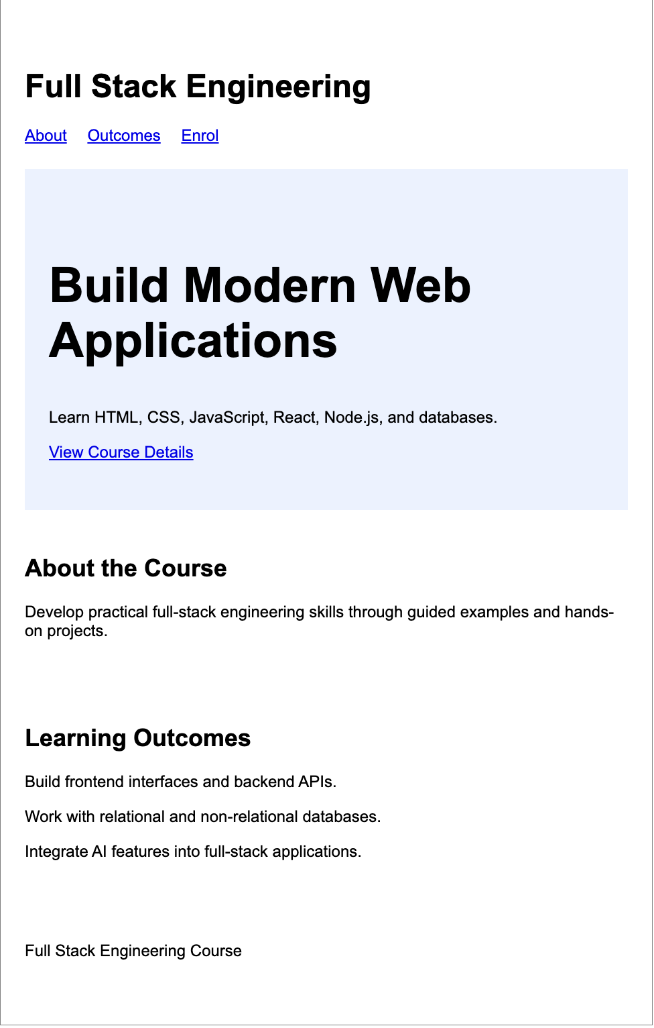
One Page, Different Screen Sizes
Observe the webpage
Open the Course Landing Page in the browser.
Gradually reduce the width of the browser window.
Notice how the page changes as the viewport becomes narrower.
Questions to consider
Does the content remain easy to read?
Does the spacing still feel comfortable?
Do any parts of the page feel crowded?
Would the page be convenient to use on a mobile phone?
Notes:
Share the HTML/CSS with learners

Slide 11
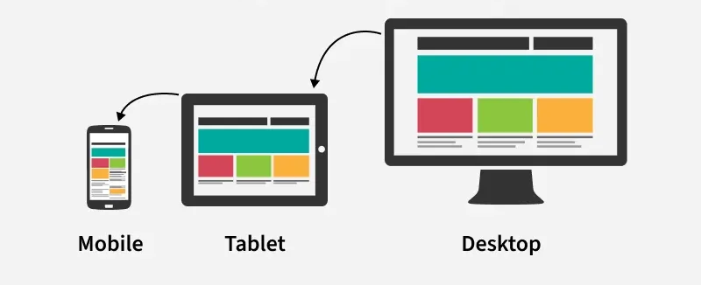
Designing for Different Screens
What is Responsive Design?
Responsive Design is the practice of creating webpages that adapt to different viewport sizes.
The content, sizing, spacing, and layout can change to remain usable across devices.
Why is Responsive Design important?
Users access websites from mobile phones, tablets, laptops, and desktop computers.
A layout that works well on a large screen may feel crowded on a smaller screen.
Responsive webpages improve readability and usability.
Responsive Design allows one webpage to support multiple screen sizes.

Slide 12
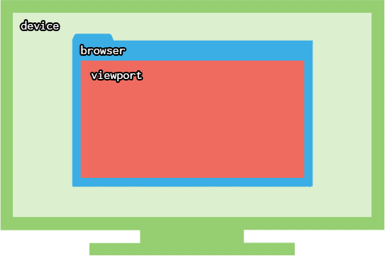
Understanding the Viewport
What is a viewport?
The viewport is the visible area of a webpage inside the browser.
CSS responds to the viewport size rather than the physical size of the device.
Common viewport categories:
Category
Typical Viewport Width
Mobile
320px to 480px
Tablet
768px to 1023px
Laptop
1024px to 1279px
Desktop
1280px and above
Important note
These ranges are useful guidelines, not fixed rules.
The same device category may contain many different viewport sizes.
Breakpoints should also consider where the webpage content begins to feel crowded or difficult to use.
Notes:
Briefly show the width value while resizing the browser. Introduce the Chrome DevTools Device Toolbar as an optional testing tool.

Slide 13
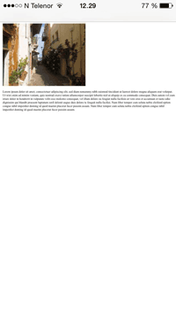
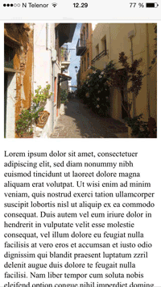
Checkpoint: Choosing the Better Mobile Experience
Version A
Version B
Which version provides the better mobile experience?
A. Version A
B. Version B
C. Both versions provide the same experience
Answer: B

Slide 14
Responsive Units

Slide 15
Fixed Widths Do Not Adapt
Consider the following Course Landing Page section:
HTML Snippet
styles.css
<section class="course-info">
<h2>About the Course</h2>
<p>Learn frontend development using HTML, CSS, and JavaScript.</p>
</section>
.course-info {
width: 600px;
padding: 24px;
border: 1px solid gray;
}
What happens when the viewport becomes narrower?
The section keeps its fixed width of 600px.
The available viewport width may become smaller than the section.
The content no longer adapts to the available space.
Question: How can we make the section width adjust when its parent becomes narrower?
Notes:
Do not introduce % until the next slide. Allow learners to identify that fixed width is causing the problem.

Slide 16
Percentage (%)
What is the Percentage (%) unit?
% represents a percentage of the parent element's size.
As the parent element changes size, the child element adjusts automatically.
Why use %?
Creates flexible layouts.
Adapts automatically to different viewport sizes.
Commonly used for containers and images.
Understanding the unit
If the parent element is 1000px wide:
Width
Actual Size
100%
1000px
75%
750px
50%
500px
25%
250px
Syntax
.course-info {
width: 90%;
}

Slide 17
Example: Fixed Width vs Percentage Width
Before
Observe
.course-info {
width: 600px;
}
Resize the browser window.
Compare how each version behaves.
Notice which layout adapts naturally.
After
Course Landing Page
Browser resize demo
.course-info {
width: 90%;
}
Notes:
Demonstrate using the Course Landing Page. Resize the browser slowly so learners can observe the difference.

Slide 18
Checkpoint: Flexible Widths
An online bookstore displays each book description inside a container. Which CSS is more suitable if the container should adapt to different screen sizes?
A. .book { width: 500px; }
B. .book { width: 90%; }
C. .book { width: 90vw; }
D. .book { width: inherit; }
Answer: B

Slide 19
Root-relative Units (rem)
What is rem?
rem is relative to the root html font size.
Why use rem?
Creates consistent typography.
Makes spacing easier to maintain.
Allows an entire website to scale consistently.
Understanding the unit
If the root font size is 16px:
Value
Actual Size
0.5rem
8px
1rem
16px
2rem
32px
3rem
48px
Syntax
h2 {
font-size: 2rem;
}
section {
padding: 2rem;
}

Slide 20
Example: Typography and Spacing with rem
styles.css
Observe
.course-card {
padding: 2rem;
}
.course-card h2 {
font-size: 2rem;
}
.course-card p {
font-size: 1rem;
}
Increase the root font size.
Notice how the heading, paragraph, and spacing scale together.
Compare the same example using px values.
Course information card
px values compared with rem values

Slide 21
Checkpoint: rem for Scaling
A product page should scale its typography consistently across the entire website. Which CSS is more appropriate?
A. h2 { font-size: 32px; } section { padding: 32px; }
B. h2 { font-size: 2rem; } section { padding: 2rem; }
C. h2 { font-size: 2vh; }
D. h2 { font-size: 20%; }
Answer: B

Slide 22
Viewport Units (vw and vh)
What are Viewport Units?
vw represents a percentage of the viewport width.
vh represents a percentage of the viewport height.
Common uses
Hero sections
Full-screen banners
Sections that should occupy a portion of the viewport
If the viewport width is 1200px
Value
Actual Width
1vw
12px
50vw
600px
100vw
1200px
If the viewport height is 800px
Value
Actual Height
1vh
8px
50vh
400px
100vh
800px

Slide 23
Example: Hero Section
styles.css
Viewport diagram
Width and height measured from visible browser area
.hero {
width: 100vw;
min-height: 60vh;
}
Important note
100vw and 100% are not always identical.
100vw is based on the viewport width.
100% is based on the width of the parent element.
Choose the unit based on what the element should respond to.
Observe
Resize the browser width.
Resize the browser height.
Observe how the hero section responds.

Slide 24
Checkpoint: Viewport Height
A travel website wants its hero banner to occupy 60% of the visible browser height. Which unit should be used?
A. %
B. vh
C. rem
D. px
Answer: B

Slide 25
Element-relative Units (em)
What is em?
em is relative to the current element's font size.
Why use em?
Useful for component-level sizing.
Allows spacing to grow together with text.
Understanding the unit
If the current font size is 20px:
Value
Actual Size
0.5em
10px
1em
20px
2em
40px
Syntax
button {
font-size: 20px;
padding: 0.5em 1em;
}

Slide 26
Example: Button Component
styles.css
Parent-child Example
button {
font-size: 20px;
padding: 0.5em 1em;
}
.card {
font-size: 20px;
}
.card p {
font-size: 1.2em;
}
Observe
Increase the button font size.
Observe how the padding increases automatically.
Important note
The paragraph size changes relative to its parent.
Nested em values can compound.
Use em thoughtfully when nesting elements.

Slide 27
Checkpoint: em-based Spacing
A shopping website increases a button font size from 20px to 30px. The padding is defined using em. What happens to the padding?
A. It becomes smaller.
B. It remains unchanged.
C. It increases proportionally.
D. It becomes zero.
Answer: C

Slide 28
Media Queries

Slide 29
Flexible Elements Are Not Always Enough
What have we improved so far?
Flexible widths using %
Scalable typography and spacing using rem
Viewport-based sizing using vw and vh
Component-level scaling using em
Course Landing Page
Navigation becomes crowded during resize
The remaining problem
Flexible elements can resize.
However, some layouts need to change their structure at smaller viewport widths.
A horizontal navigation bar may become crowded on a mobile viewport.
Question: How can CSS apply a different layout when the viewport becomes narrower?

Slide 30
Applying CSS Conditionally
What is a Media Query?
A Media Query allows CSS rules to be applied only when a specified condition is true.
It helps a webpage adapt its presentation to different viewport sizes.
How does it work?
The browser evaluates the condition.
If the condition is true, the CSS rules inside the Media Query are applied.
If the condition is false, the CSS rules inside the Media Query are ignored.
General Structure
@media (condition) {
/* CSS rules */
}

Slide 31
Understanding the Condition
What is a Media Query condition?
A condition tells the browser when the CSS rules should be applied.
Example condition
max-width: 600px
Meaning: Apply the styles when the viewport width is 600px or smaller.
Complete Media Query
@media (max-width: 600px) {
/* CSS rules for smaller viewports */
}
Breakdown
@media begins the Media Query.
(max-width: 600px) defines the condition.
{ } contains the CSS rules applied when the condition is true.

Slide 32
Example: Responsive Navigation
HTML Snippet
CSS for Smaller Viewports
<nav class="course-nav">
<a href="#">Home</a>
<a href="#">Curriculum</a>
<a href="#">Instructor</a>
<a href="#">Enroll</a>
</nav>
@media (max-width: 600px) {
.course-nav a {
display: block;
margin-bottom: 12px;
}
}
Default CSS
.course-nav a {
display: inline;
margin-right: 16px;
}
Expected Result
Above 600px, the navigation links remain on the same line when space is available.
At 600px or smaller, each navigation link begins on a new line.

Slide 33
Understanding Breakpoints
What is a Breakpoint?
A Breakpoint is a viewport width at which a webpage changes its presentation.
It is commonly used inside a Media Query condition.
How are Breakpoints chosen?
Breakpoints are often selected around common viewport categories.
The exact value should also depend on where the content begins to feel crowded or difficult to use.
Example
@media (max-width: 600px) {
nav a {
display: block;
}
}
In this example, 600px is the Breakpoint.

Slide 34
Common Breakpoint Ranges
Viewport Category
Typical Width
Mobile
320px to 480px
Viewport width changes gradually
Layout changes at selected Breakpoints
Tablet
768px to 1023px
Laptop
1024px to 1279px
Desktop
1280px and above
Important Note
These values are general guidelines.
A Breakpoint should be added when the content or layout requires a change.
Developers should not depend only on specific device models.

Slide 35
Responsive Websites in Practice
Observe a responsive website
Suggested Websites
Resize the browser and notice:
GitHub
MDN Web Docs
BBC News
What changes?
Navigation
Images
Typography
Spacing
Section widths
What remains the same?
At which viewport width does the layout change?
Live browser resize & observations
Notes:
Use one or two websites. Keep the observation brief. Ask learners to share changes in the chat.

Slide 36
Checkpoint: Choose the Correct Media Query
An online bookstore wants its category links to appear on separate lines when the viewport is 768px or smaller. Which Media Query should be used?
A. @media (max-width: 768px) { .category-link { display: block; } }
B. @media (min-width: 768px) { .category-link { display: block; } }
C. @media (width: 768px) { .category-link { display: block; } }
D. @media (screen-width: 768px) { .category-link { display: block; } }
Answer: A

Slide 37
Checkpoint: Predict the Result
Consider the following CSS. What happens when the viewport width becomes 500px or smaller?
styles.css
.notice {
font-size: 1rem;
}
@media (max-width: 500px) {
.notice {
font-size: 1.25rem;
}
}
A. The notice becomes smaller.
B. The notice becomes larger.
C. The notice is hidden.
D. The Media Query is ignored.
Answer: B

Slide 38
Mobile-First Approach

Slide 39
Two Ways to Write Responsive CSS
Stylesheet A: Desktop-First
Stylesheet B: Mobile-First
.course-title {
font-size: 2.625rem;
}
@media (max-width: 768px) {
.course-title {
font-size: 1.75rem;
}
}
.course-title {
font-size: 1.75rem;
}
@media (min-width: 768px) {
.course-title {
font-size: 2.625rem;
}
}
Observe
Stylesheet A begins with the larger-screen style.
Stylesheet B begins with the smaller-screen style.

Slide 40
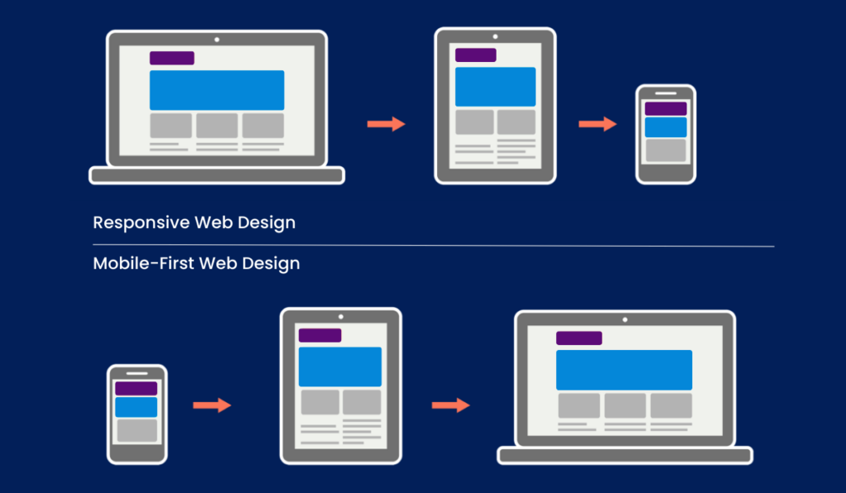
Starting with Smaller Screens
What is the Mobile-First approach?
Mobile-First is an approach where the base CSS is written for smaller viewports first.
Additional styles are added as more viewport space becomes available.
How does it work?
Write the simplest layout as the default.
Use Media Queries to enhance the page for tablets, laptops, and desktops.
Why use Mobile-First?
Keeps the base CSS focused and simple.
Encourages developers to prioritize essential content.
Supports a clear and maintainable CSS structure.

Slide 41
Understanding min-width
What does min-width mean inside a Media Query?
@media (min-width: 768px) {
/* CSS rules */
}
Pattern
/* Base styles for smaller viewports */
@media (min-width: 768px) {
/* Enhancements for wider viewports */
}
Apply the enclosed CSS rules when the viewport width is 768px or wider.
Compare the conditions
max-width: 768px applies styles at 768px or smaller.
min-width: 768px applies styles at 768px or larger.
Mobile-First Pattern
Base styles are written for smaller viewports.
min-width Media Queries add enhancements for wider viewports.

Slide 42
Example: Mobile-First Course Heading
HTML Snippet
Enhancement for Larger Viewports
<section class="course-hero">
<h1 class="course-title">
Full Stack Engineering
</h1>
<p>Learn to build modern web applications.</p>
</section>
@media (min-width: 768px) {
.course-hero {
padding: 3rem;
}
.course-title {
font-size: 2.625rem;
}
}
Base CSS for Smaller Viewports
.course-hero {
padding: 1.5rem;
}
.course-title {
font-size: 1.75rem;
}
Expected Result
Below 768px, the section uses smaller spacing and typography.
At 768px or wider, the section receives more spacing and a larger course title.

Slide 43
Checkpoint: Identify the Mobile-First Stylesheet
A restaurant website should use smaller text by default and increase the heading size on wider viewports. Which stylesheet follows the Mobile-First approach?
A. .menu-title { font-size: 2.5rem; } @media (max-width: 700px) { .menu-title { font-size: 1.75rem; } }
B. .menu-title { font-size: 1.75rem; } @media (min-width: 700px) { .menu-title { font-size: 2.5rem; } }
C. .menu-title { font-size: 2.5rem; }
D. @media (width: 700px) { .menu-title { font-size: 1.75rem; } }
Answer: B

Slide 44
Putting It All Together

Slide 45
Activity: Responsive Course Landing Page
Objective
Apply Responsive Units, Media Queries, and the Mobile-First approach to a Course Landing Page.
Page Sections
Header
Course title
Navigation links
Hero section
Main heading
Course description
Enrolment link
Course information
Overview and learning outcomes
Footer
Build progressively
Complete unfinished milestones as homework

Slide 46
HTML Starter
<header class="site-header">
<h1>Full Stack Engineering</h1>
<nav class="course-nav">
<a href="#about">About</a>
<a href="#outcomes">Outcomes</a>
<a href="#enrol">Enroll</a>
</nav>
</header>
<main class="page-content">
<section class="course-hero">
<h2>Build Modern Web Applications</h2>
<p>Learn HTML, CSS, JavaScript, React, Node.js, and databases.</p>
<a href="#enrol">View Course Details</a>
</section>
<section id="about" class="course-section">
<h2>About the Course</h2>
<p>Develop practical full-stack engineering skills through guided examples and hands-on projects.</p>
</section>
<section id="outcomes" class="course-section">
<h2>Learning Outcomes</h2>
<p>Build frontend interfaces and backend APIs.</p>
<p>Work with relational and non-relational databases.</p>
<p>Integrate AI features into full-stack applications.</p>
</section>
</main>
<footer class="site-footer">
<p>Full Stack Engineering Course</p>
</footer>

Slide 47
CSS Starter
body {
}
.site-header,
.page-content,
.site-footer {
}
.site-header {
}
.course-nav a {
}
.course-hero {
}
.course-hero h2 {
}
.course-section {
}
.site-footer {
}
Starting Point
The base CSS is designed for smaller viewports.
Navigation links begin on separate lines.
Widths and spacing use responsive units.

Slide 48
Milestone 1: Flexible Content
Update the page content
Use % for the main page width.
Add max-width to prevent the content from becoming too wide on larger screens.
Check
Resize the browser.
The content should adapt to narrower viewports.
The content should remain readable on wider viewports.
Suggested CSS
.site-header,
.page-content,
.site-footer {
width: 90%;
max-width: 900px;
margin: 0 auto;
}

Slide 49
Milestone 2: Responsive Typography & Spacing
Update the hero section
Use rem for the heading size.
Use rem for padding.
Use vh for the minimum hero height.
Check
The hero should remain readable on smaller viewports.
The section should occupy a meaningful portion of the viewport height.
Suggested CSS
.course-hero {
min-height: 50vh;
padding: 2rem 1rem;
}
.course-hero h2 {
font-size: 2rem;
}

Slide 50
Milestone 3: Responsive Navigation
Add a Mobile-First Media Query.
Expected Result
Suggested CSS
Below 768px
Navigation links appear on separate lines.
At 768px or wider
Navigation links appear on the same line when space is available.
@media (min-width: 768px) {
.course-nav a {
display: inline;
margin-right: 1rem;
margin-bottom: 0;
}
}

Slide 51
Milestone 4: Larger-Viewport Enhancements
Add larger-screen styles.
Check
Suggested CSS
The mobile layout remains the default.
Larger viewports receive more spacing and larger typography.
The page remains usable at each viewport size.
@media (min-width: 768px) {
.course-hero {
padding: 4rem 2rem;
}
.course-hero h2 {
font-size: 3rem;
}
.course-section {
padding: 2.5rem 0;
}
}

Slide 52
Homework
Responsive Event Landing Page
Create a webpage for an upcoming event.
Required Sections
Event title
Event description
Navigation links
Event schedule
Registration link
Footer
Responsive Requirements
Use % for a flexible content container.
Use rem for typography or spacing.
Use vh for the hero section.
Write at least one Media Query.
Follow the Mobile-First approach.
Use clear and meaningful class names
Submission Requirements
Index.html
styles.css

Slide 53
That's it for today!
Any questions?

